Slide 1
Mutilmodal Abnormality Detection - Result

Slide 2
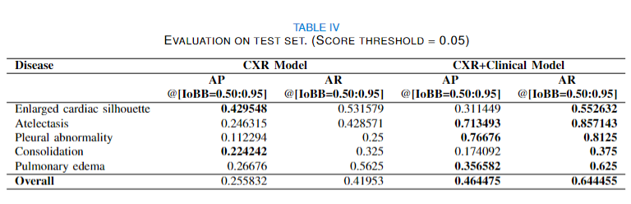
1. Adding clinical data improves AP and AR.
3 of the 5 diseases gain improvement on Average Precision (AP) when including clinical data. And the overall performance of CXR+Clinical model is considerably better than the CXR model.
CXR+Clinical model has better Average Recall (AR) among all diseases .

Slide 3
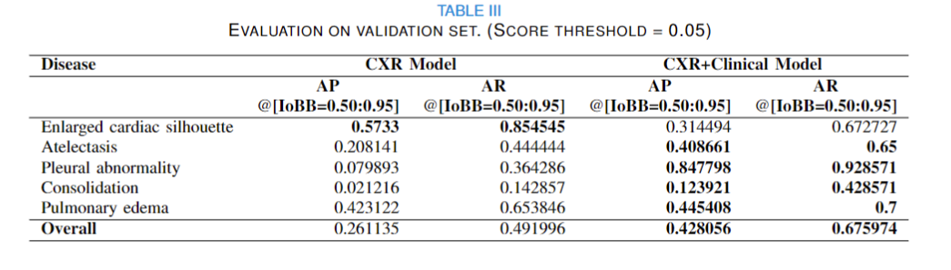
2. The CXR+Clinical can detect Consolidation better on validation dataset.
The only disease with obvious performance drop on both validation and test sets is “Enlarged cardiac silhouette”.
But why? Can radiologists help us to justify this?

Slide 4
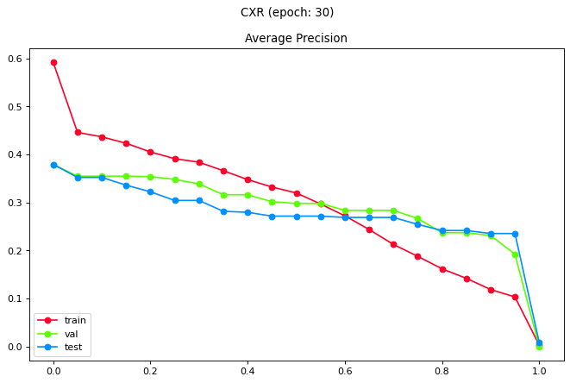
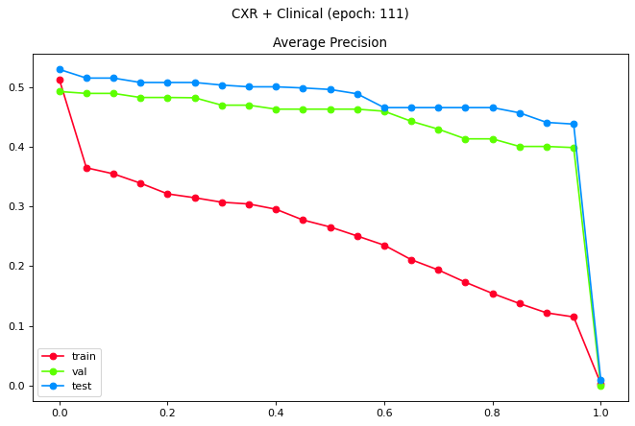
2. Adding clinical data improves generalisation.
The CXR+Clinical model doesn’t have performance drop on validation and test sets. They’re actually have better performance compared to training set.
(Note: the early stop strategy is applied to obtain these models, so they both are great in terms of generalization.)

Slide 5
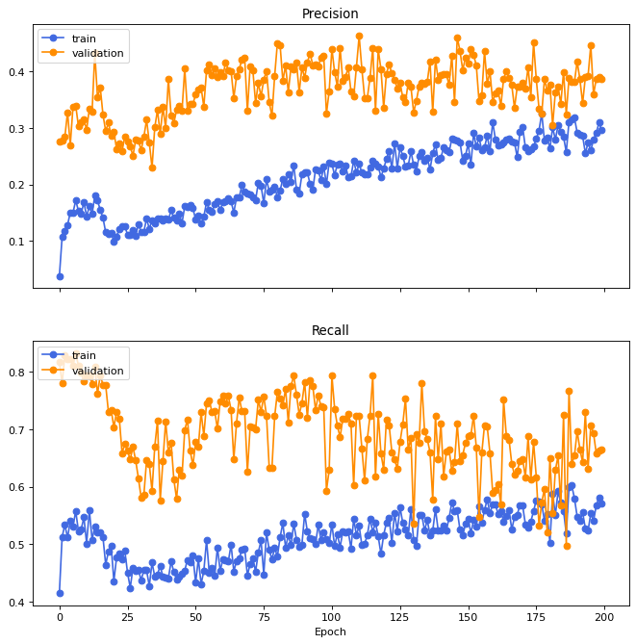
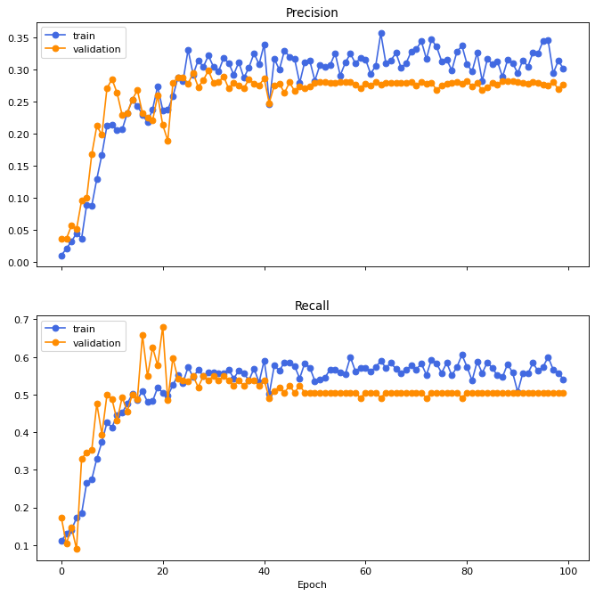


3. Training graphs show the same behavior.
Best Model
Best Model
Shows underfitting initially.

Slide 6
IoBB threshold and Score threshold.
We have two changeable thresholds in this work, IoBB threshold and score threshold.
The IoBB threshold is used for determine whether a prediction meet the label properly. (has enough overlapping between prediction and ground truth.)
The score is a predicted value from model. It tells how confident the model is about the prediction. The value is between 0 and 1. A higher value means the model has more confidence on this certain prediction. The score threshold is then used to help us filtering out the predictions with small score value. Then default value for Mask RCNN is 0.05, but it will still have too much noise if we want to generate the bounding boxes for visualization. 0.1 seems to be a better value, with only small performance drop.

Slide 7
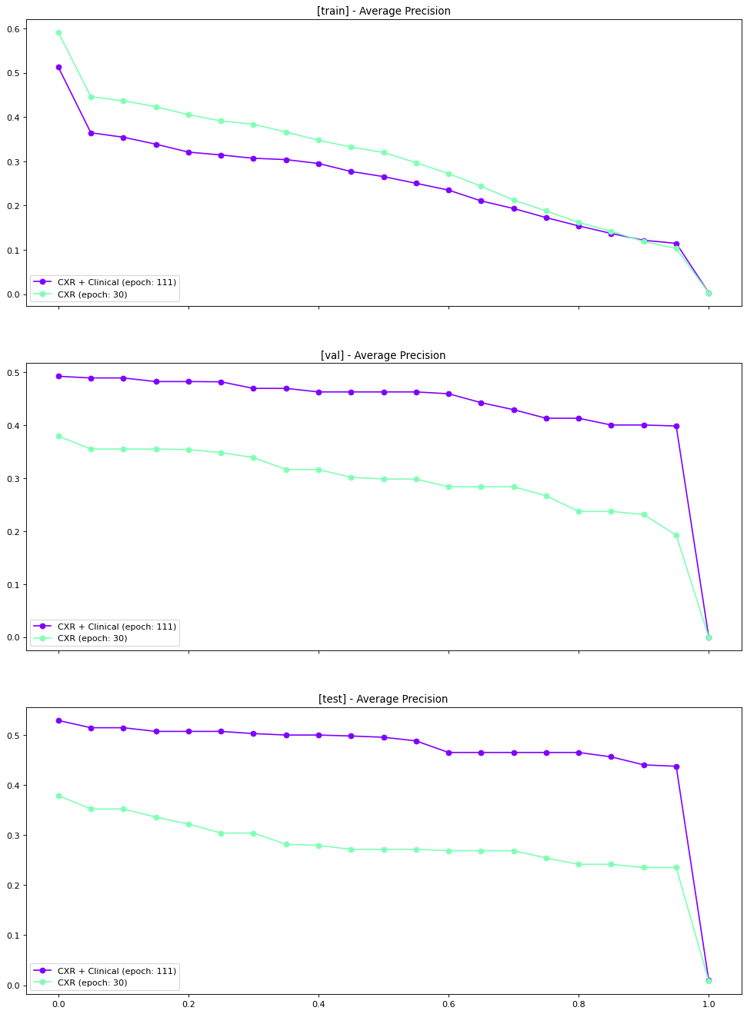
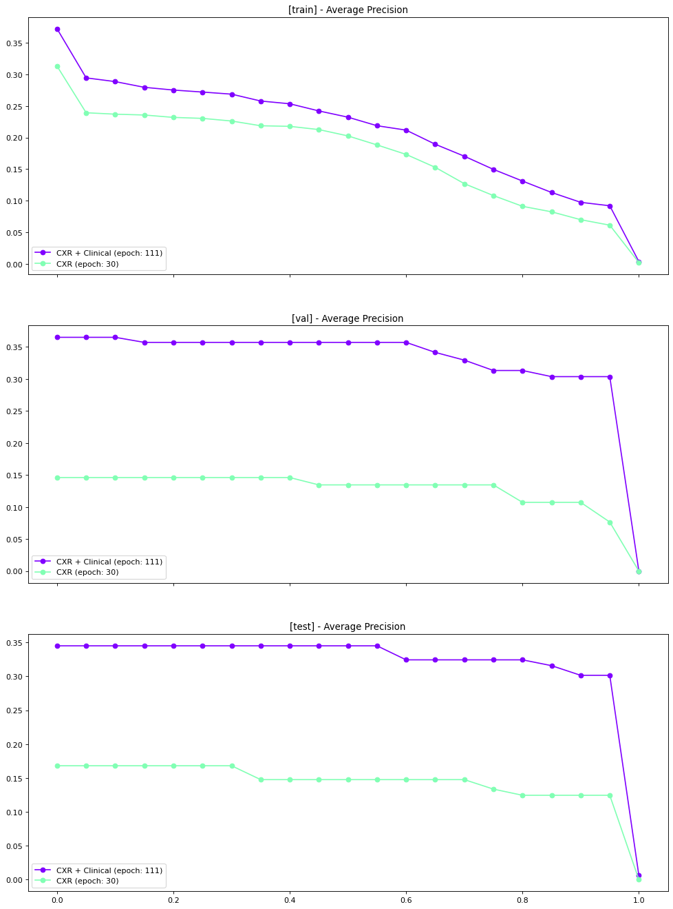
3. Adding clinical data improves score. (confidence)
The three charts on the left-hand side are the performance on training, validation and test set when using score_thrs=0.05. And the graph on right-hand side was generated using score_thrs=0.3.
The purple line and cyan line represents CXR+clinical model and CXR model respectively.
By comparing these two graphs, we notice the purple line is much higher than the cyan line when score_thrs = 0.3. In the training graph, the performance of CXR+Clincal are even better than the CXR model, which means the CXR+Clinical has more confidence (score) when it suspects an abnormality.
score_thrs = 0.05
score_thrs = 0.3

Slide 8
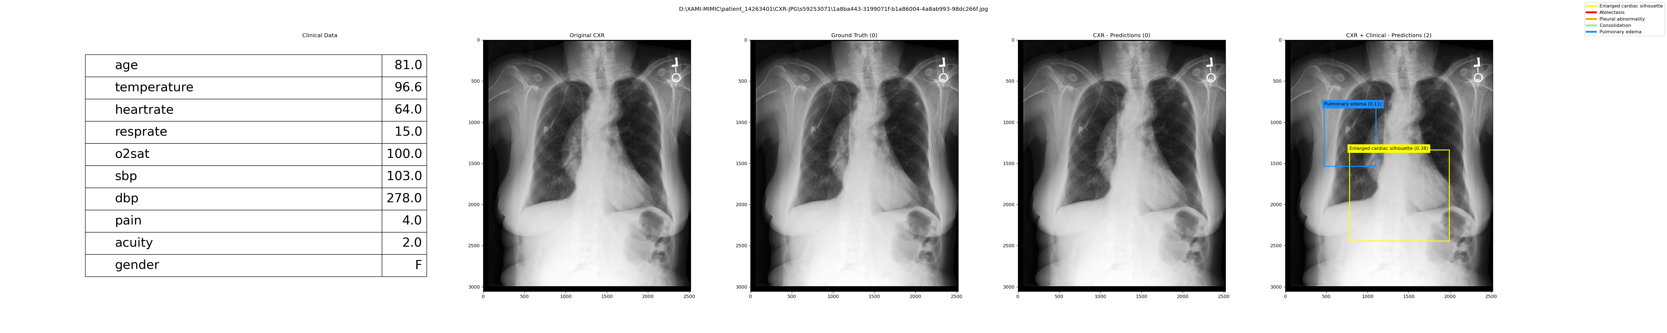
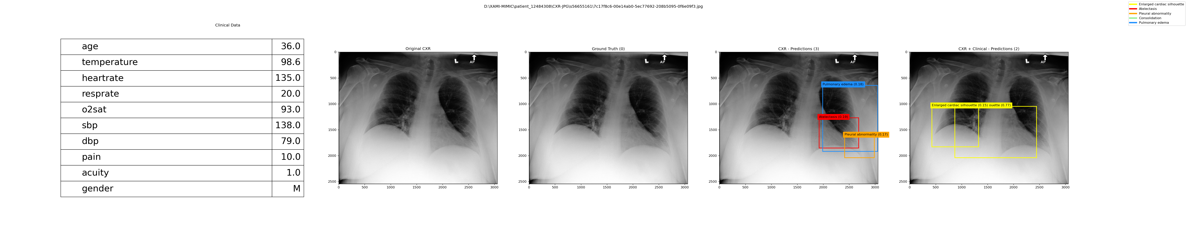
4. CXR+Clinical model has more false positive cases on Enlarged cardiac silhouette.
As the testing result shows, the CXR+Clinical model has higher recall on Enlarged cardiac silhouette but resulting more false positive cases.

